Slide 1

Manufacturing Downtime Analysis Project
DEPI_4 Data Analysis Power Bi

Slide 2
Agenda
1) Team Members
2) Project Overview
3) Data Analysis Steps
4) Collecting Data
5) Cleaning
6) Modeling
7) Feature Engineering (Dax)
8) Sample Visuals
9) Visualization Reports
10) Visualization Dashboard

Slide 3

1)Team Members
Abram sobhy bekhit
Osama Khalil Abdel Fadil
Youssef Basher El-Sayed
Fady Milad Sadeq
Jana Ehab Mohamed

Slide 4
2)Project Overview
This project focuses on analyzing manufacturing production data to understand and reduce production downtime. Downtime refers to the periods when the production line stops due to various operational issues such as machine failures, operator errors, inventory shortages, or process adjustments.
The dataset contains information about production batches, operators, production start and end times, product details, and the factors that caused downtime during the production process.
Using Power BI, the goal of this project is to clean, transform, and model the data in order to build interactive dashboards that help identify the main causes of downtime, measure production efficiency, and support better operational decisions.
By analyzing this data, we can discover patterns in production interruptions, determine the most frequent downtime factors, evaluate operator-related issues, and identify opportunities to improve production performance.

Slide 5
3)Data Analysis Steps
1) Collecting Data
2) Cleaning
3) Modeling
4) Sample Visual
5) Reports
6) Dax
7) Dashboard

Slide 6
4)Collecting Data (Source)
We collected data from DEPI.
This data allows us to perform proper data cleaning, including handling missing values, correcting names, detecting inconsistencies, calculating durations, identifying outliers, and validating ranges.
The goal is to ensure high-quality, consistent data for reliable analysis.
Ultimately, this supports data-driven decisions to improve machine productivity.

Slide 7
5)Data Cleaning
Cleaning steps:
1/we Appropriate columns data types to avoid any errors
2/from filter we unselect null values from end time column
3/we replace blank values in operator column with unknown
4/we transform table downtime to "unpivot shape" to be clear in visualization
5/we transform values in product column with standard name to each product
6/Remove Duplicate Rows from Downtime Table

Slide 8
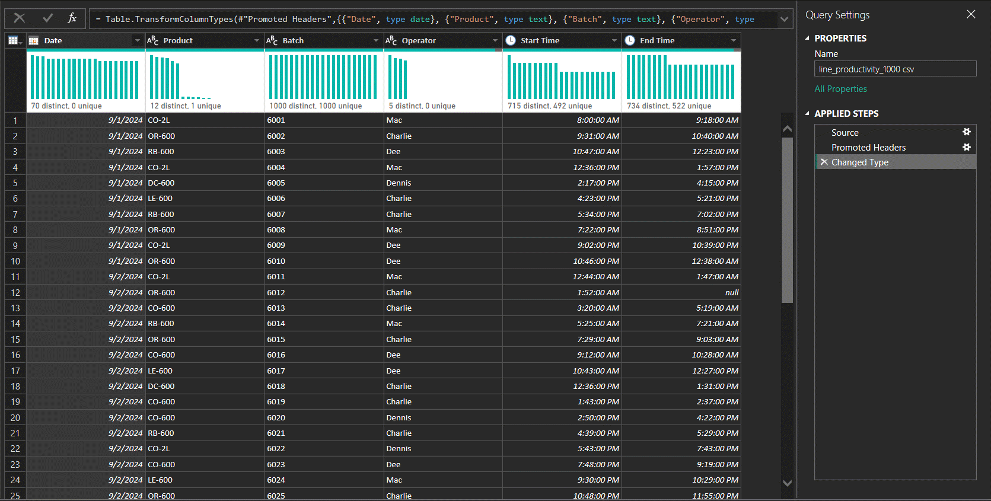
Before

Slide 9
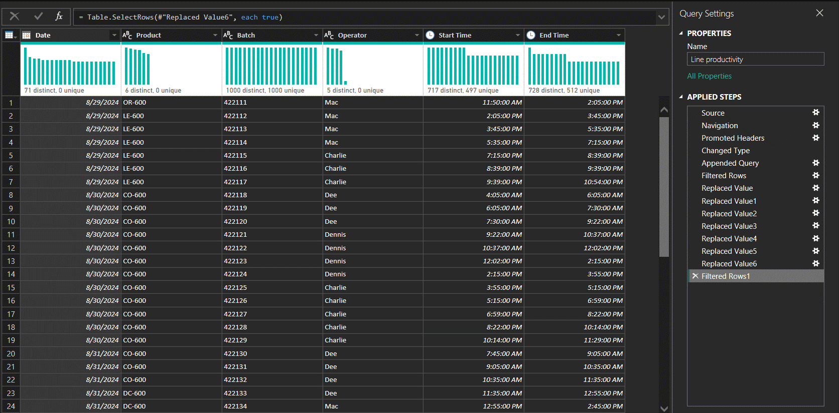
After

Slide 10
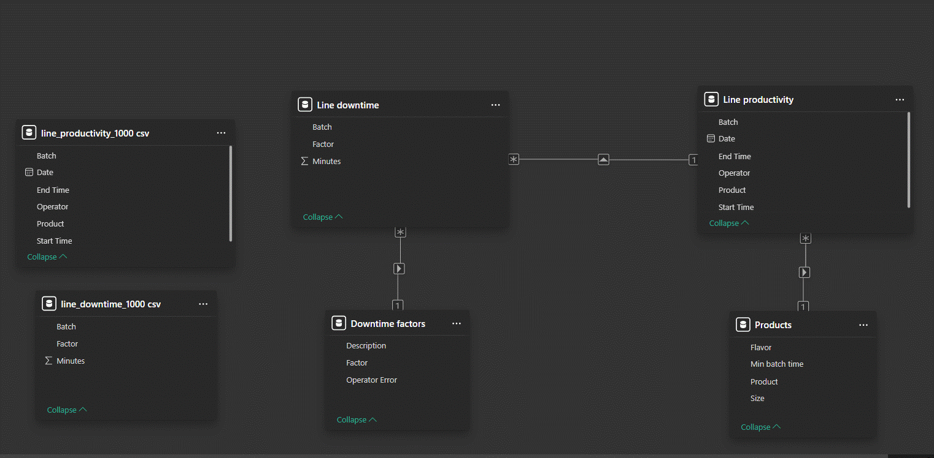
6)Data Modeling

Slide 11
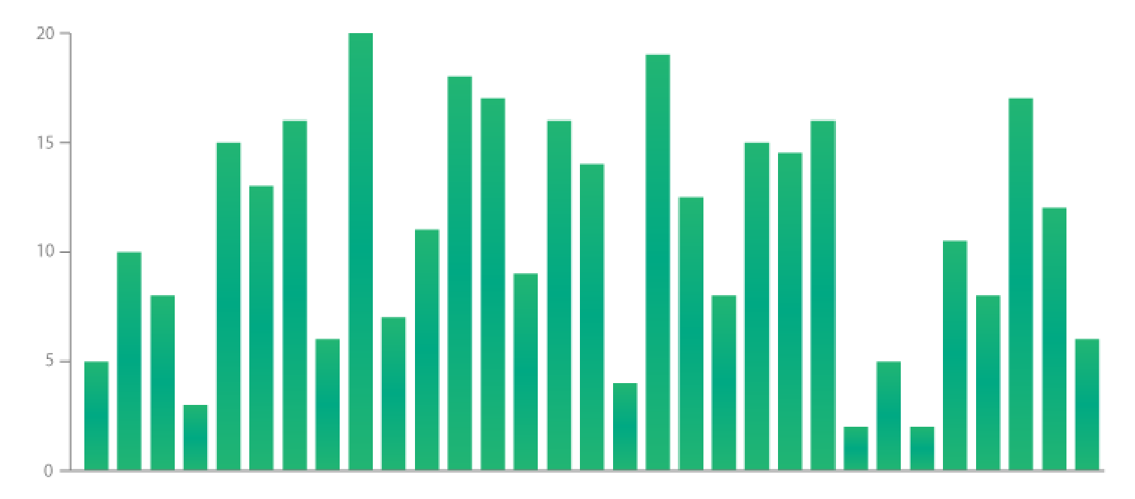
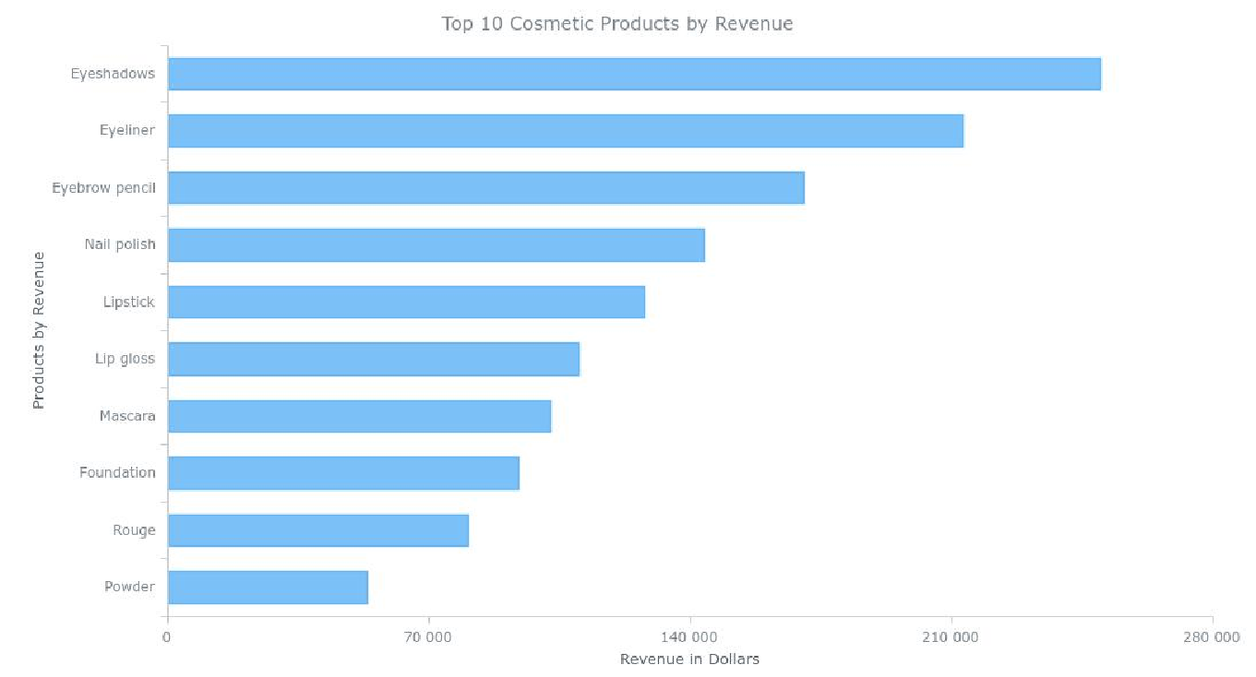
1.Bar Chart
6)Sample Visuals
The classic Bar Chart uses horizontal or vertical bars.
Columns to show discrete, numerical comparisons across categories.

Slide 12
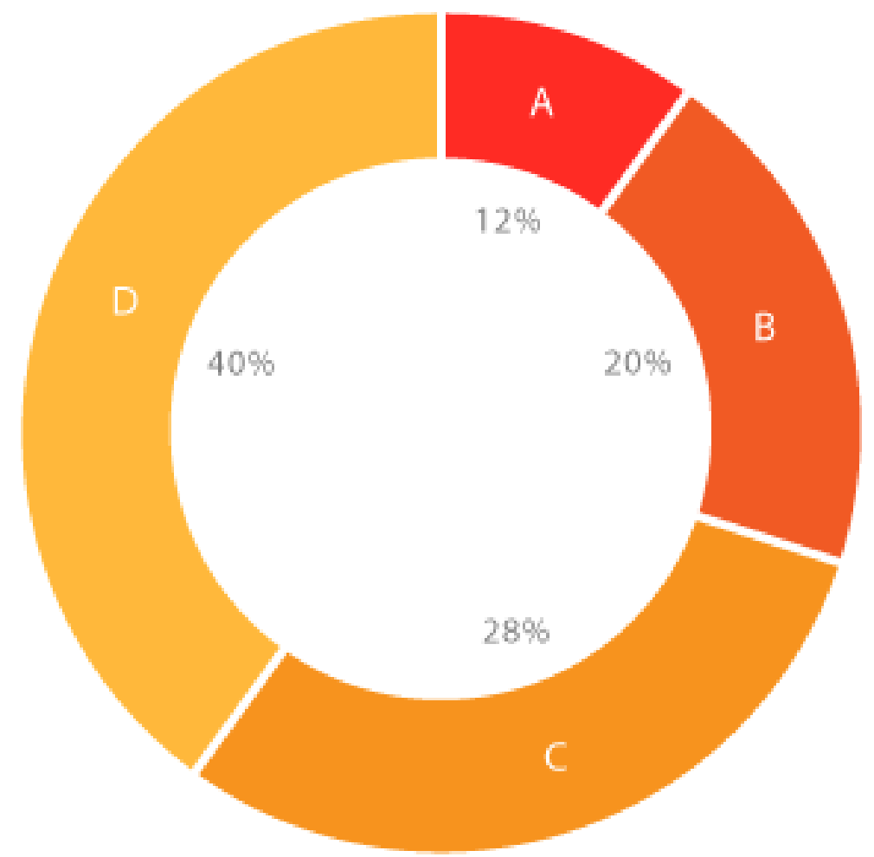
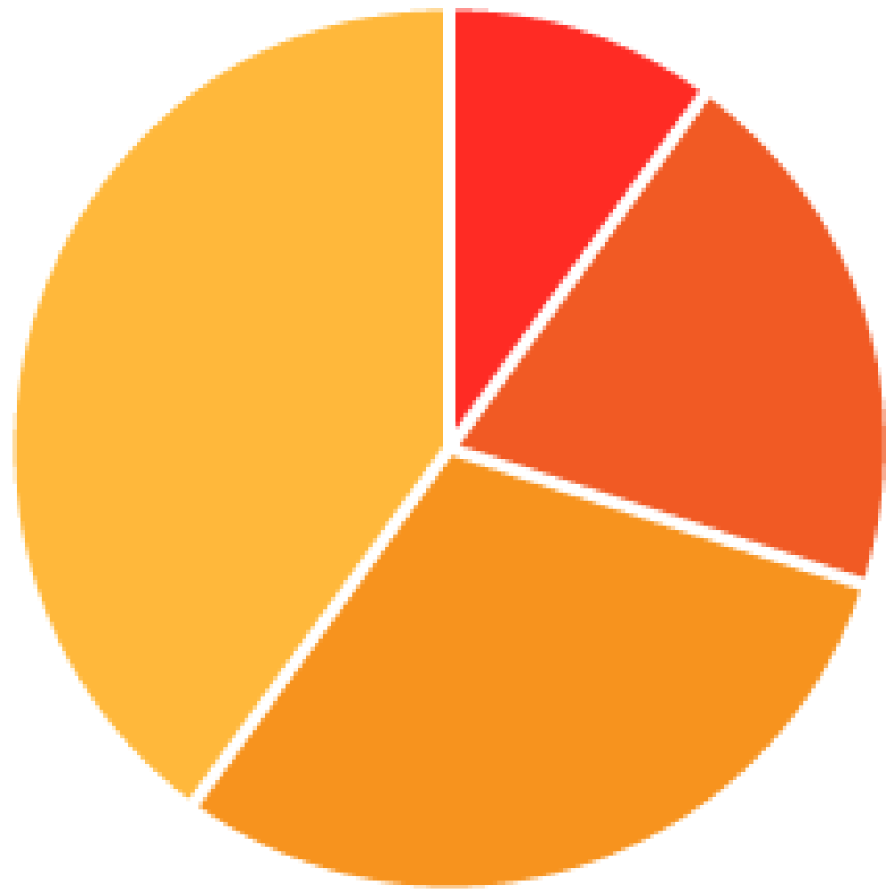
2.Pie & Donut Charts
Pie & donut charts are ideal for giving the reader a quick idea of the proportional distribution of the data.

Slide 13
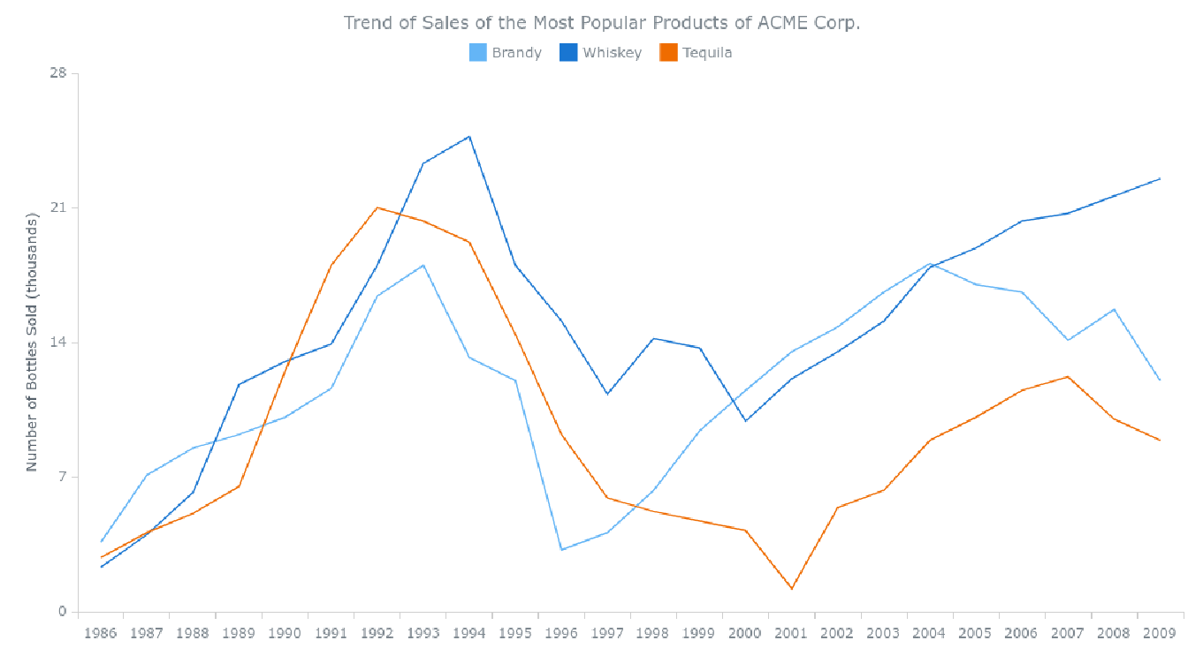
3.Line Chart
Line Graphs display quantitative values over a continuous interval or time.
A Line Graph is most frequently used to show trends and analyze how the data has changed over time.

Slide 14
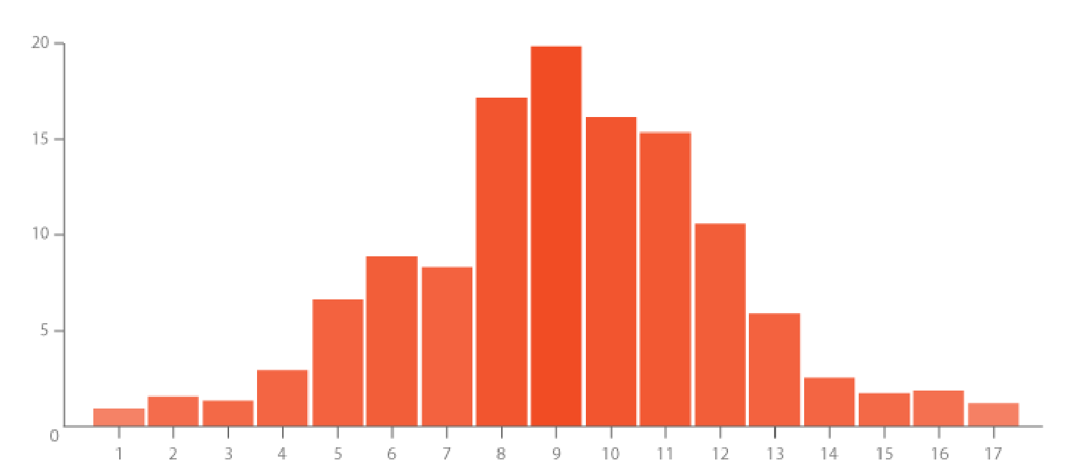
4.Histogram
A Histogram visualizes data distribution over a continuous interval or a certain time.
Each bar in a histogram represents the tabulated frequency at each interval/bin.

Slide 15
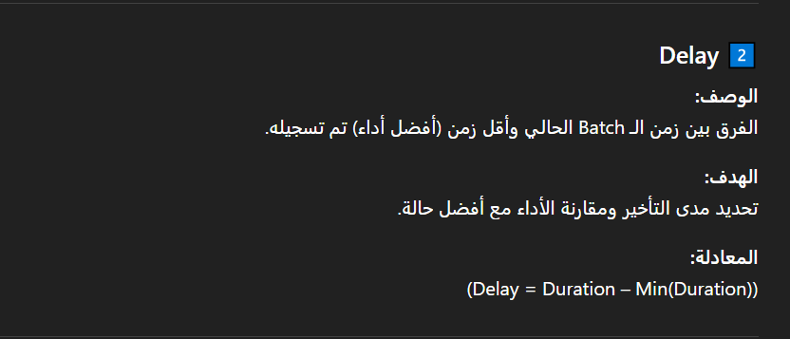
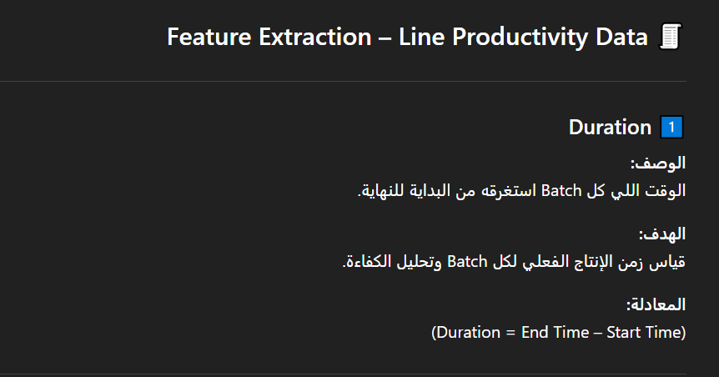
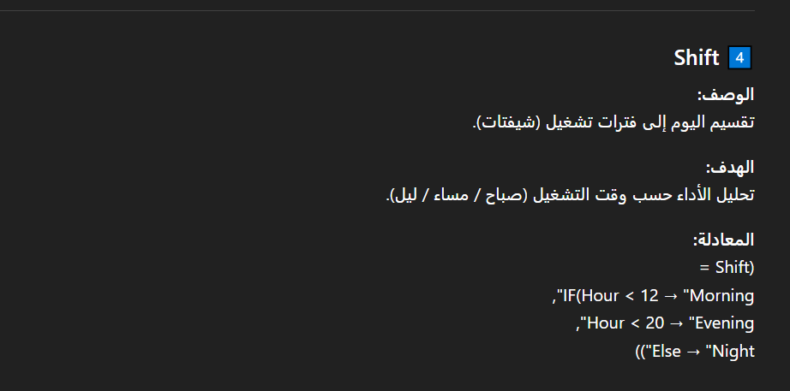
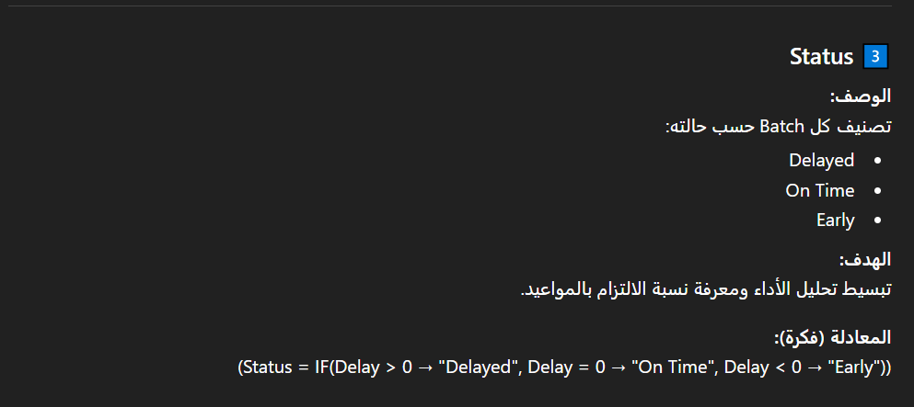
7)Feature Engineering(DAX)

Slide 16
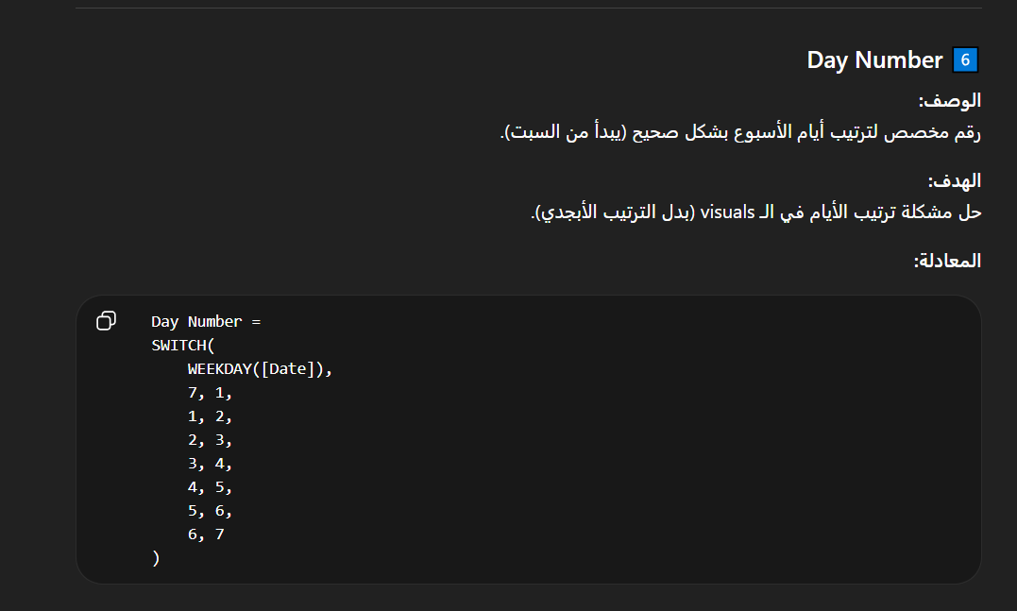

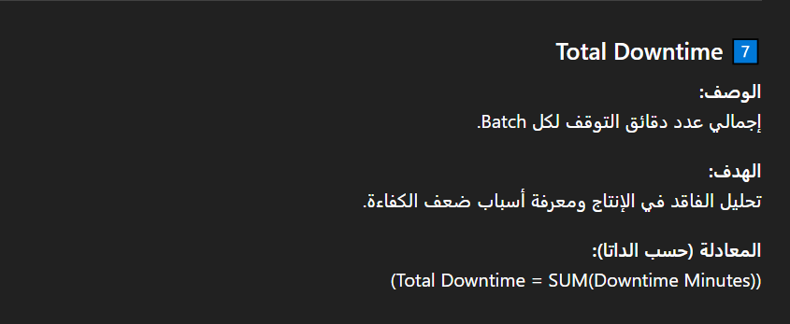
Notes
Columns are calculated at the row level and return a value for each individual record.
Measures are used for aggregations and calculations based on the current filter context.
The Day Number column is used to ensure correct chronological sorting of weekdays in visuals instead of alphabetical order.

Slide 17
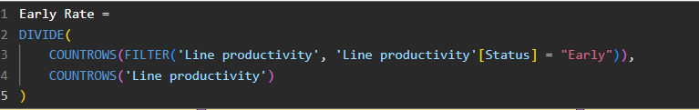
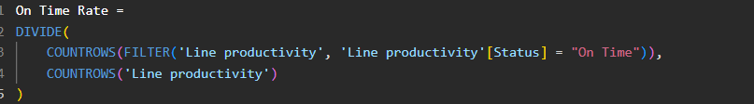
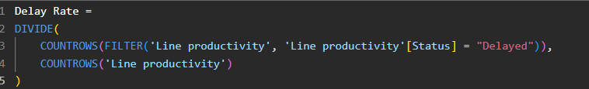
DAX
1) Measures

Slide 18
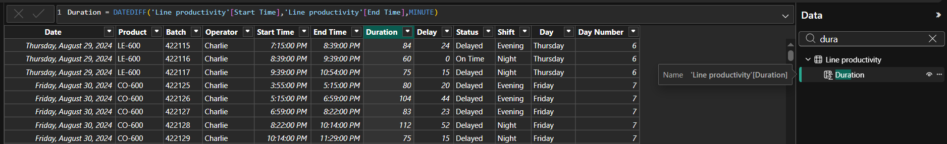
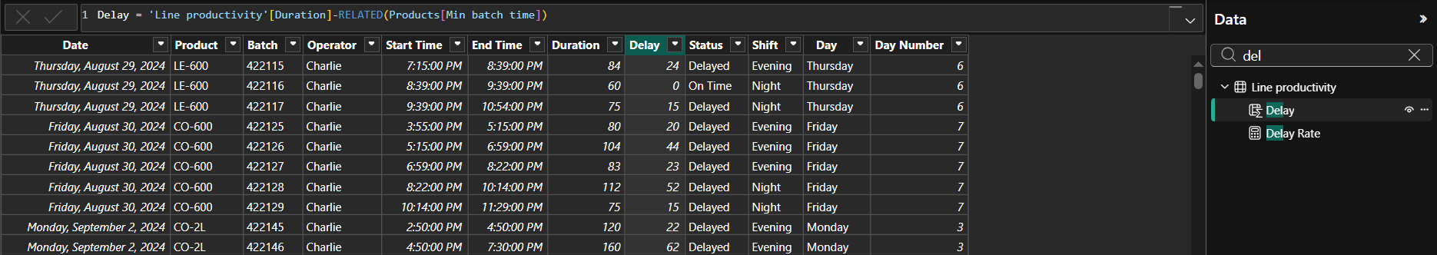
DAX
2) Columns

Slide 19
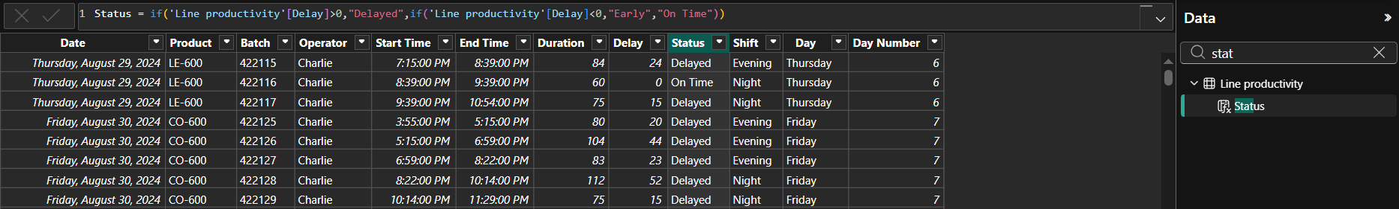
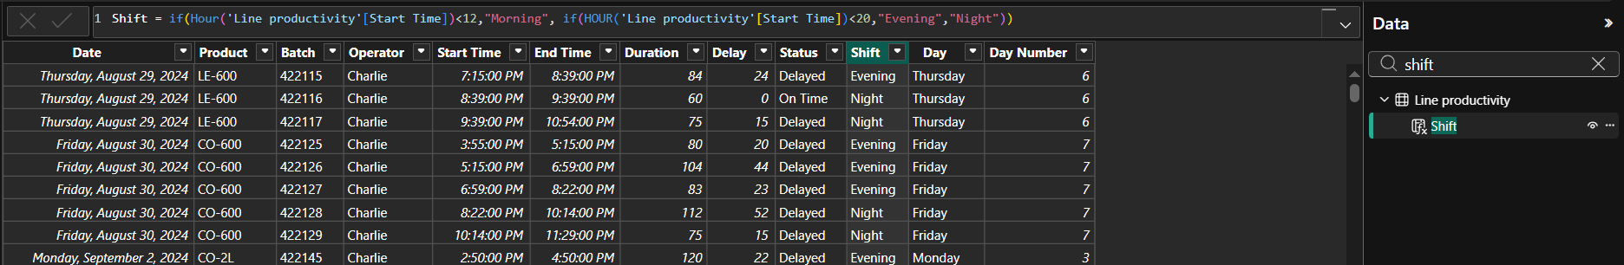
DAX
2) Columns

Slide 20
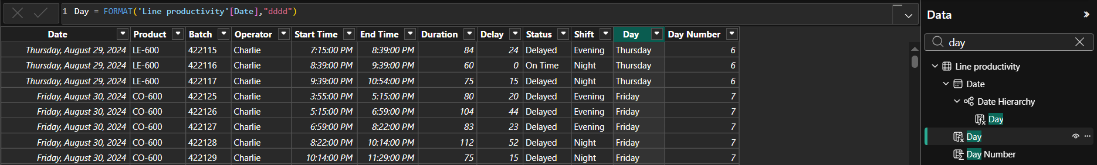
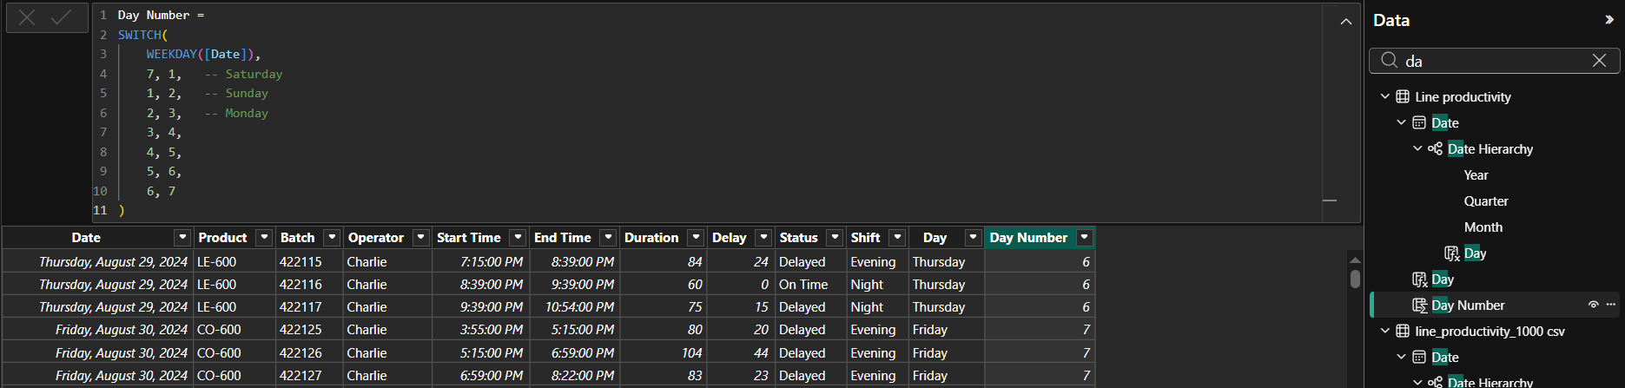
DAX
2) Columns

Slide 21
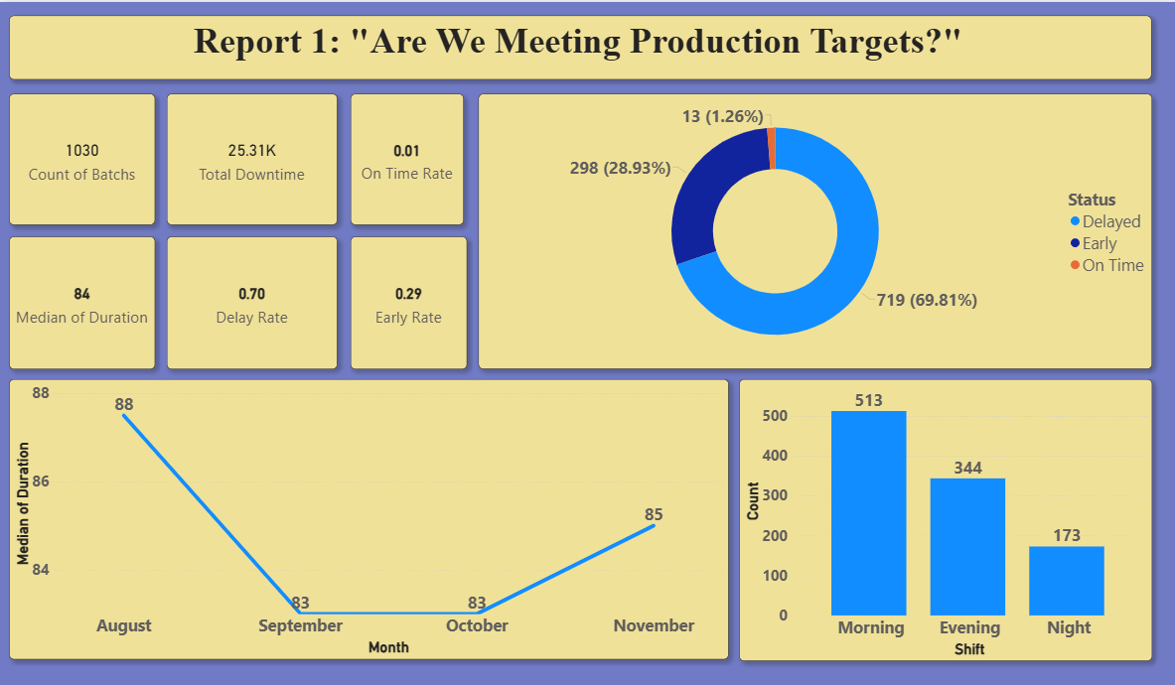
9)Visualization Power BI Reports

Slide 22
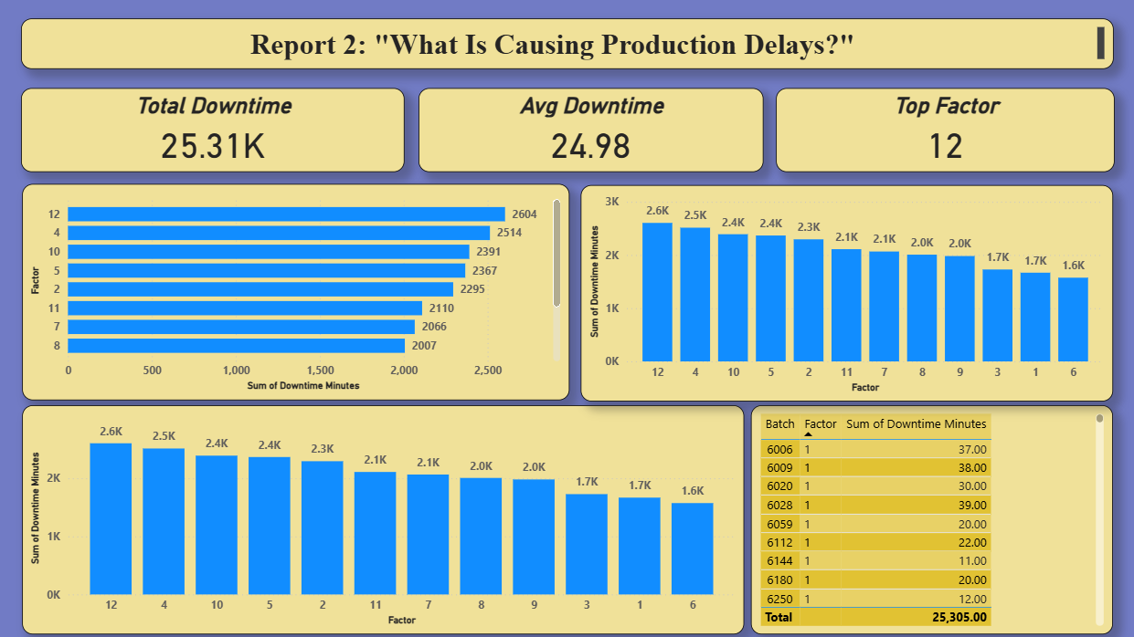

Slide 23
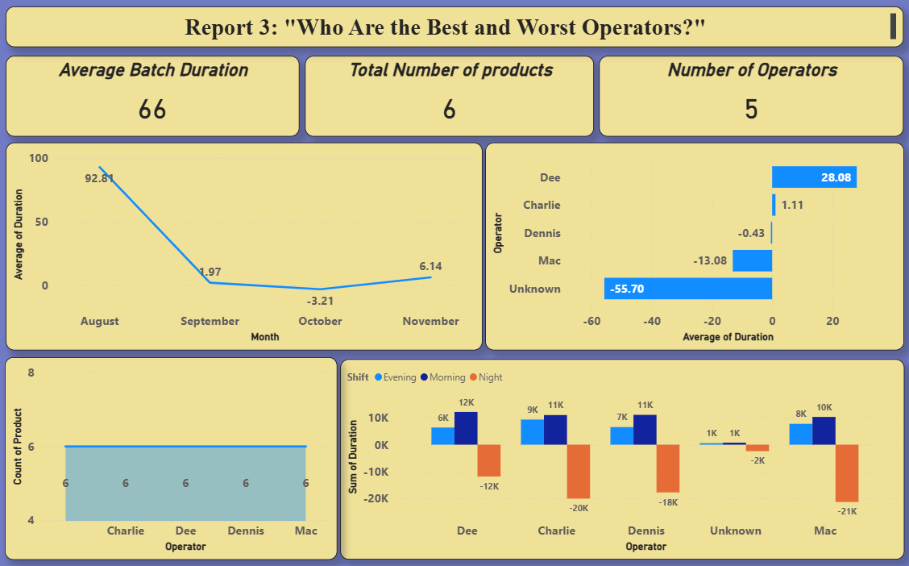

Slide 24
10)Visualization Dashboard

Slide 25

Thank You
GitHub Link

